Slide 1
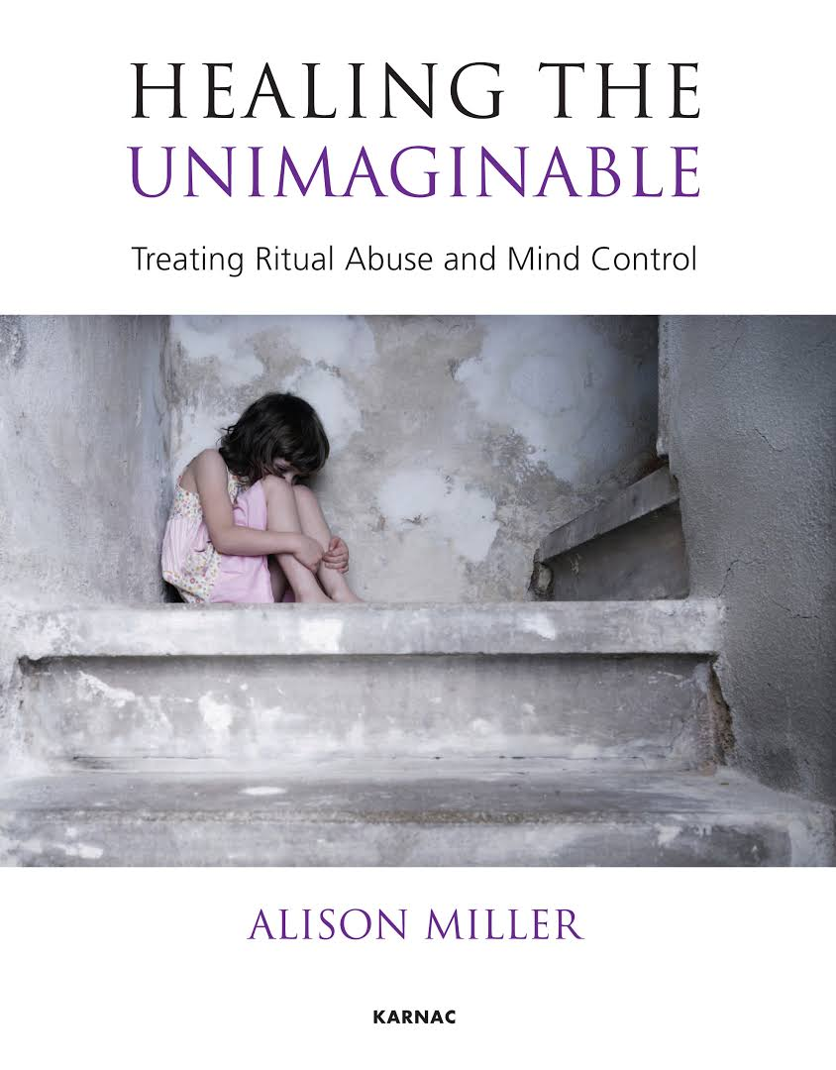
2025 Survivorship Conference
Clinician Day 16th May
Successful Investigations of Extreme Abuse Cases –
The Role of Mental Health Professionals in Family Courts
Dr Rainer Hermann Kurz
C.Psychol
ichinendaimoku@gmail.com
For ‘Thorge’
The name Thorge has Irish origins and is derived from the Gaelic name Ó Tormaigh, meaning "descendant of Tormaigh". The name Tormaigh itself is believed to come from the word tormach, which means "thunder". This gives the name a strong and powerful connotation, often associated with resilience and authority.
https://www.researchgate.net/profile/Rainer-Kurz/publications

Slide 2
Abstract
Successful Investigations of Extreme Abuse Cases –
The Role of Mental Health Professionals in Family Courts
Dr. Rainer Hermann Kurz, London
A recent study (Meier, 2020) trawled from electronic records the outcomes of US child custody cases involving allegations of abuse and ‘parental alienation’. It showed how discredited theories, bias and lack of understanding of abuse can lead to unsafe judgements. These issues appear to be magnified when it comes to allegations of extreme child sexual abuse.
Salter & Woodlock (2023) advocate for strategic forms of knowledge production in which ignorance features as a provocation towards information-seeking rather than as a defence mechanism against intolerable realities when it comes to organized abuse, in which multiple adults sexually abuse multiple children. This presentation reviews successful prosecutions of Extreme Abuse Cases that are in the public domain as well as three case studies.
In the first case study, a mother permanently lost custody of her toddler boy as four Court Appointed Experts claimed that she was delusional about a, having delivered as a young teenager a baby that succeeded from incestuous rape and ‘disappeared’ and b, witnessed a sexual assault on her toddler boy by a ‘stalker’. Extracts of ‘expert’ reports are compared to privately commissioned reports from half a dozen specialists that found no reason to disbelieve the mother’s account and explained her ‘information processing issues’ as somatoform dissociation symptoms.
In the second case study, extracts of an extreme abuse survivor’s ‘CV’ are used to illustrate ‘unbelievable’ traumas, psychiatric impact and healing over five decades.
In the third case study, a mother lost custody of her daughter who aged 12 disclosed ‘organized abuse’ including CSAM production (Salter & Wong, 2024). Police, social services, mental health professionals and the judge perpetuated a relentless ‘Discourse of Disbelief’ and fell for classic ‘gaslighting’ ruses. Medical records and psychological symptoms (Silberg, 2021) consistent with Chronic Child Sexual Abuse and objective forensic opportunities were ignored.
The case studies illustrate how ignorance and allegations of ‘mental ill health’ driven by vested interest appear to drive unsafe judgements (‘child smuggling’?) in family courts. The recommendations of Meier (2021) are applied to cases where extreme abuse allegations have been raised.

Slide 3
References &
Learning Objectives
Successful Investigations of Extreme Abuse Cases –
The Role of Mental Health Professionals in Family Courts
Dr. Rainer Hermann Kurz, London
References:
Meier, J. (2020). U.S. child custody outcomes in cases involving parental alienation and abuse allegations. Journal of Social Welfare and Family Law, 42(1), 92–105. https://doi.org/10.1080/09649069.2020.1701941
Meier, Joan S., "Denial of Family Violence in Court: An Empirical Analysis and Path Forward For Family Law" (2021). GW Law Faculty Publications & Other Works. 1536. https://scholarship.law.gwu.edu/faculty_publications/1536
Salter, M., & Woodlock, D. (2023). The antiepistemology of organized abuse: Ignorance, exploitation, inaction. The British Journal of Criminology, 63(1), 221-237. https://doi.org/10.1093/bjc/azac007
Salter, M., & Wong, T. (2024). Parental Production of Child Sexual Abuse Material: A Critical Review. Trauma, Violence, & Abuse, 25(3), 1826-1837. https://doi.org/10.1177/15248380231195891
Silberg, J. L. (2021). The child survivor: Healing developmental trauma and dissociation. Routledge. https://doi.org/10.4324/9781351048866
Learning Objectives:
Participants will be able to:
1. Describe how ‘Parental Alienation’ and abuse allegations interact in family court settings.
2. List three cases involving successful prosecutions of extreme abuse and violence.
3. Understand the role of mental health professionals in dealing with allegations of extreme abuse.

Slide 4
Dr Rainer Kurz
BPS Letter & Article

Slide 5
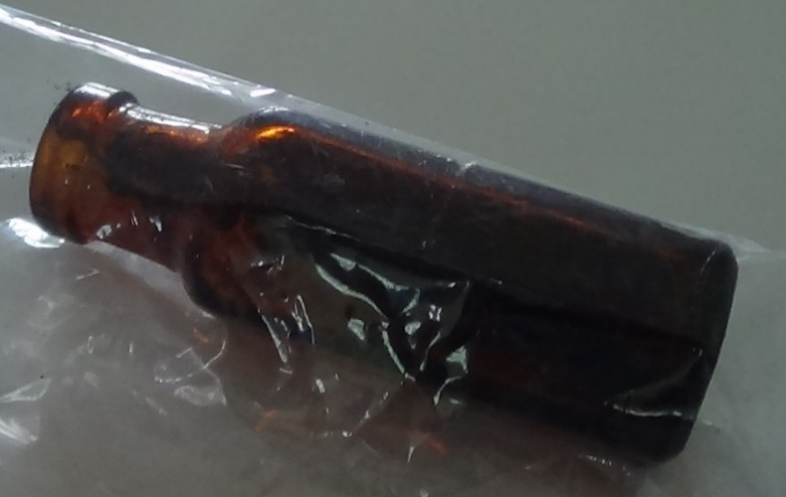
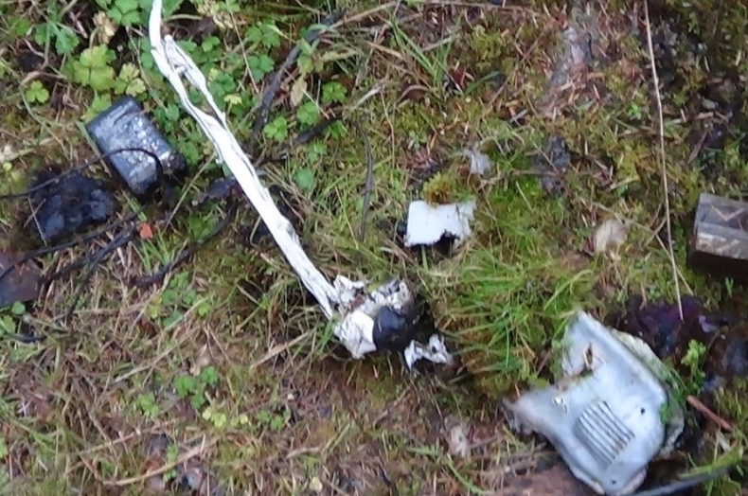
Puzzle
How do these artefacts relate?
https://www.researchgate.net/publication/315723456_Critical_Reflections_on_the_Role_of_Mental_Health_Professionals

Slide 6
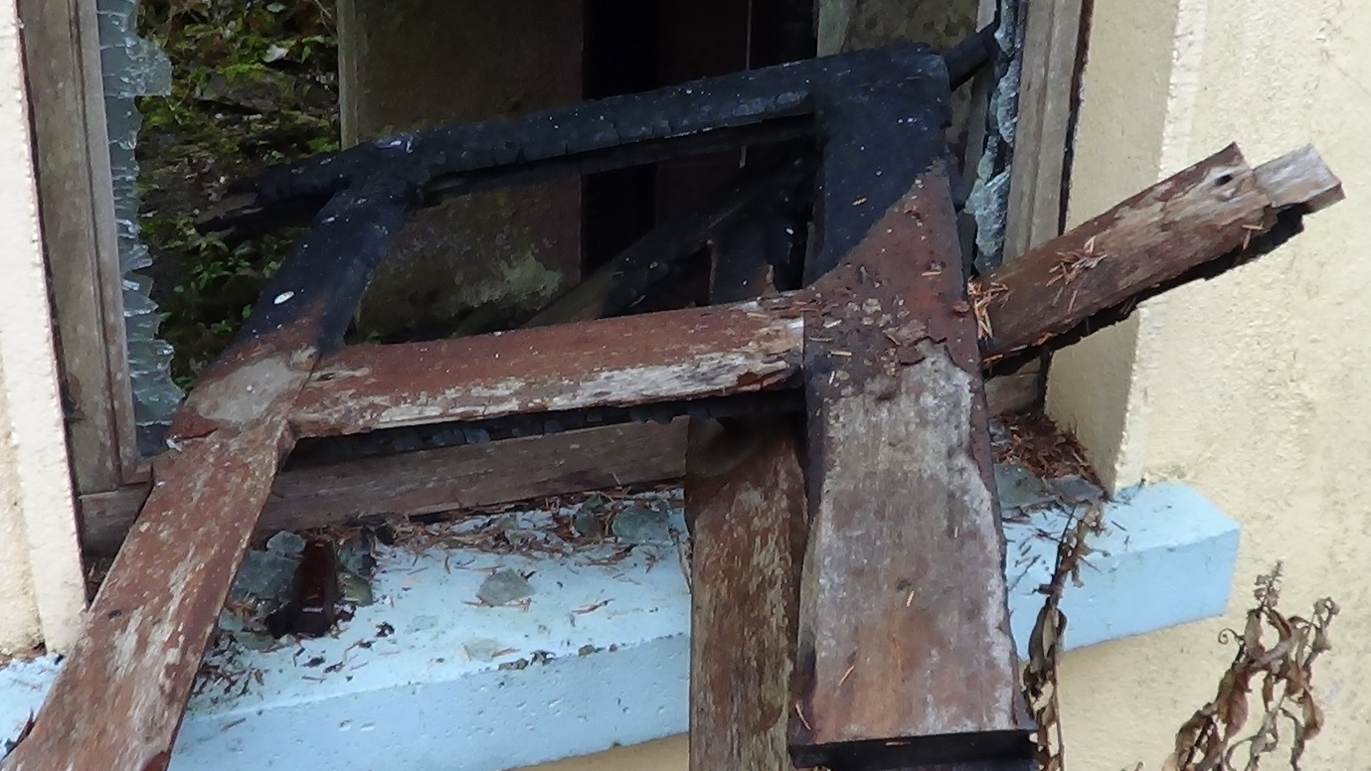
Puzzle
Low Stability, High Plasticity?
https://arsoninformer.files.wordpress.com/2014/09/suspected-arson-murder.pdf
https://www.researchgate.net/publication/315723456_Critical_Reflections_on_the_Role_of_Mental_Health_Professionals

Slide 7
Structure
‘Parental Alienation’ (PA) Impact on Family Courts
Successful Prosecutions of Extreme Abuse
3. ‘Child Smuggling’ Case Vignettes
4. ‘Survivor CV’ Case Vignettes
5. ‘Gaslighting’ Case Vignettes
6. Prof Michael Salter Academic Research

Slide 8
Child Sexual Abuse
& C-PTSD
‘When child sexual abuse is mentioned, many people have an image in their minds of a deviant man dressed in ragged clothes with no job or living in the backwoods.
This description is wrong.
Child sexual abusers look like everyone else, often hold high-esteem jobs, and can be women. Sexual abusers cross all demographic lines, including income, race, sex, and where they live.
30-40% of child sexual abuse victims are abused by a close family member rather than a stranger, with 50% of victims being harmed by someone outside the family that the family knows and trusts, such as a pastor or a boy scout leader.
About 40% of child sexual abuse victims are abused by older or larger children that they know, with 50% of these children being under the age of 12.’
https://cptsdfoundation.org/2021/04/05/childhood-sexual-abuse-and-complex-post-traumatic-stress-disorder/

Slide 9
Meier (2020)
Abuse Allegations trigger
Custody Loss

Slide 10
Mother’s Custody Loss &
Parental Alienation

Slide 11
PA Custody Loss
‘Magic Wand’
& Academic Controversies

Slide 12
Meier (2021)
Recommended Citation Meier, Joan S., "Denial of Family Violence in Court: An Empirical Analysis and Path Forward For Family Law" (2021). GW Law Faculty Publications & Other Works. 1536. https://scholarship.law.gwu.edu/faculty_publications/1536

Slide 13
Meier (2021)
Pages 67 & 68

Slide 14
Meier (2021)
Pages 72 & 73

Slide 15
The Psychometric Forum
‘Personality and Politics’ Event
http://www.psychometricsforum.org/
Politics and the Psychology of Abuse and Cover-up
Dr Rainer Hermann Kurz
C.Psychologist
ichinendaimoku@gmail.com

Slide 16
Delusion
Definition
A recent UK court custody case quoted ‘Blacks Medical Dictionary’ (Marcovitch, 2010):
‘Delusions An irrational and usually unshakeable belief peculiar to some individual. They fail to respond to reasonable argument and the delusion is often paranoid in character with a belief that a person or persona is/are persecuting them. The existence of a delusion, of such a nature as to seriously influence conduct, is one of the most important signs in reaching a decision to arrange for the compulsory admission of the patient to hospital for observation. (See Mental Illness).’
The DSM-V definition (American Psychiatric Association, 2013, p. 819) remains identical to the DSM-III (p. 765) and DSM-IV-TR (p.821):
delusion a false belief based on incorrect inference about external reality that is firmly sustained despite what almost everyone beliefs and despite what constitutes incontrovertible and obvious proof or evidence to the contrary.
A Google Search on 18/01/2014 did not result in a single entry that quotes the first definition sentence of Black’s Medical Dictionary.
A Google Search on 18/01/2014 brought up 154 entries that quote literally this first DSM Delusion definition sentence.

Slide 17
Successful UK
Prosecutions
1982 Malcolm & Susan Smith and Albert & Carole Hickman, were convicted in Telford, Shropshire for a series of sexual and physical assaults against children during the course of satanic rituals.
1988 Old Bailey Hazel Paul plus 2 other offenders performed ritual abuse
1989 Nottingham Crown Court, 10 intergenerational family offenders abused 21 children
1989 St Albans Crown Court, Peter MacKenzie plus one other satanic offender (includes babies being abused and killed)
1990 Worcester Crown Court, Reginald Harris abused two sisters 15 years and younger
1992 Liverpool Crown Court; uncle raped niece three times a week between 10 and 12
1993/93 Manchester Crown Court, Michael Horgan (mate of Cyril Smith) raped daughter & and stepson and let others rape them
1993 Ealing Old Bailey Case, four family members abused 7 children
1994 Pembrokeshire, Swansea Crown Court, 6 men abused 13 children
1998 A West Country Crown Court, 6 men and 3 women in intergenerational abuse family; case had been reported 30 years earlier but not taken seriously; one dedicated police officer persevered; 300 interviews
2011 Kidwelly, Swansea Crown Court, Colin and Elaine Batley and two other women
https://www.researchgate.net/publication/279993748_Politics_and_the_Psychology_of_Abuse_and_Cover-up
https://casra.org.uk/prosecuted-cases/

Slide 18
Review of Kurz (2015) TPF Paper
‘Politics and the Psychology
of Abuse and Cover-up’
If the title of this presentation didn’t capture attention, the enthusiasm and passion from Rainer Kurz certainly did. This fascinating presentation asked prominent, poignant questions such as “how cover ups such as the Jimmy Savile case are possible?” Rainer illustrated a comparison of the use of psychometrics within the workplace, which is highly visible and guided by best practice, with the use of psychometrics within clinical and forensic settings where life-altering decisions are made in secrecy – sometimes with little regard for ethics of test use. By presenting research mapping personality factors to competency frameworks, an approach many of us are familiar with, Rainer illustrated how the underpinning competencies for many jobs share great similarities and it is the nuances and language which vary. This was highlighted through the discussion of the fascinating work by Silvester (2012) which describes the recruitment process for politician candidates and the mapping of conservative and liberal democrat competencies. For two parties who appear to have very different values and such contrasting opinions the similarities of the requirements for MP candidates were remarkably similar. The presentation went on to reflect upon the use of profiles which claim to assesses ‘derailment traits’ which can lead to ‘labelling’ and using terms which begin encroaching into clinical territory without the full understanding of their descriptions. Rainer prefers the terminology of ‘overextension risks’ which mandates judicious exploration of actual behaviours in the light of environmental pressures and opportunities. Rainer brought home the fact that proper use of psychometric assessments for forensic and clinical settings is vital through a case study of a lady who had her child taken away from her on the basis of a psychometric assessment. She had experienced early trauma as a child which led to somatoform dissociation. The results of occupational tools did not identity anything as being particularly problematic. However, results on the Millon Clinical Multiaxial Inventory questionnaire, a very widely used clinical personality test 2nd only to the well-established MMPI, appeared to signal problematic ‘traits’ – just as intended by those who stood to gain from a negative diagnosis (i.e. abusers). For example, positively phrased questions on the narcissistic scale seem to indicate narcissism while negatively scored questions actually indicate absence of depression. The disturbing logic of this test seems to be that anyone who is not depressed or anxious MUST be narcissistic. There appears to be lower content validity for the reverse scored items of the scale as they appear to be similar to those on other assessments which measure emotional stability – a highly socially desirable trait - rather than narcissism. Occupational assessments are used to identify strengths, include tentative phrasing and are typically interpreted with an appreciation of the influence of contextual factors and the error of measurement. However, the computer-based test interpretation (CBTI) reporting for the MCMI clinical personality test tends to be riddled with toxic, hostile and dangerous language which focuses on finding weaknesses. The issue becomes even more pressing when we consider the recommended use of such tools. Despite being designed for development purposes this tool is being used to guide critical decisions in forensic settings and the consequences of over-interpretation can be extreme. Rainer illustrated this by saying 10,000 children a year are put into forced adoption – up to 85% unnecessarily – often due to vague ‘psychological issues’ that their parents ostensibly have. Rainer’s main point was that manipulative people can play the system, and psychologists do not see through the scheming (or are too afraid to confront dangerous abusers) so that victims and witnesses of offences end up being persecuted within family courts due to misinterpretation and over reliance on results of poorly constructed and interpreted assessments. He went on to discuss the impact of false memories. It is thought that because of the media, financing and the denial culture it had become very difficult for people to come forward to discuss abuse which resulted in reluctance to investigate and prosecute cases in recent times. The culture is now changing with abuse reports being taken more seriously and investigations taking place. To avoid scandals like the Jimmy Savile case all test users to be ‘switched on’ and adhere to guidelines around testing. We all need to dismantle the ‘discourse of disbelieve’ culture that makes it so difficult for abuse to be identified and discussed. This thought provoking presentation really highlighted the need to reflect on test use and the interpretation of results from assessments.
https://www.researchgate.net/publication/279993748_Politics_and_the_Psychology_of_Abuse_and_Cover-up

Slide 19
Kidwelly (Wales)
Colin & Elaine Batley
Imagine the shock then at news of an occultist group operating behind the doors of seemingly normal new-build houses. Shock, the locals say, is something of an understatement.
As residents went about their daily life, they could not have imagined that Colin Batley, described as an "evil paedophile", was running a satanic sex cult from his home.
The self-styled high priest of the group, headed a paedophile ring run like a "quasi-religion".
Cult ringleader Colin Batley Colin Batley has been told he faces a lengthy prison sentence
One victim, who was repeatedly abused by Batley, told how he treated women like slaves. Batley would wear a hood to abuse his victims.
Once in their grasp, he would call the children to his service by clicking his fingers.
Batley and three other members of the cult were found guilty of more than 40 sexual offences against children and young adults.

Slide 20
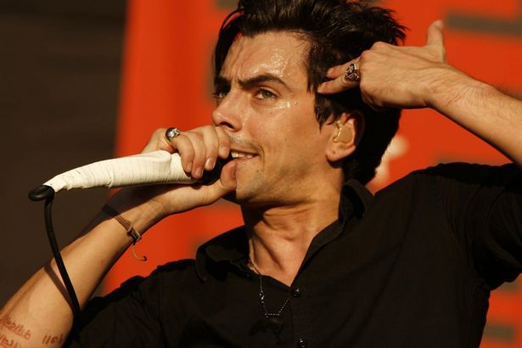
Pontypool (Wales)
Ian Watkins
UK media coverage of the Ian Watkins case was extremely muted. Wales Online was seemingly the only media outlet providing clues that Ian Watkins may well have fallen under the spell of a ‚devil worshipping sex cult‘:
http://www.walesonline.co.uk/all-about/ian%20watkins?pageNumber=1
Starstruck youngsters even offered to worship Satan if he wanted them to.
He had some weird sociopathic tendency to think he was above the law and everything. He didn’t come across as horrible. He came across as charismatic, charming and into the person he was talking to. He was just very confident and believed that whatever he did he would be okay. He thought he was a rock god and he thought he would get away with everything.
He wanted to rape and kill children. He wanted to rape newborns. He liked bestiality.
He described himself openly as ‘evil’.
The criminal investigation recovered abuse massive amounts of pornographic images. The computer password cracked by security services was ‚If***kids‘. Among the damning evidence presented by the prosecution were email exchanges between Watkins and the ‚Superfans‘ setting up planned abuse sessions in a hotel, and video-taped evidence of the attempted baby rapes. The ruling gives graphic details of the abuse acts.
‘For rape of a child under 13 where there is abuse of trust or more than one offender acting together the suggested range is 11 to 17 years with a starting point of 13 years. ‘
https://www.judiciary.uk/wp-content/uploads/JCO/Documents/Judgments/r-v-watkins-and-others.pdf
https://www.researchgate.net/publication/315722663_BRIDGEND_'BEBO'_SUICIDES_AND_RITUAL_VIOLENCE_IN_WALES

Slide 21
Bridgend (Wales)
Albert & Carolee
Hickman
https://www.bbc.co.uk/news/uk-wales-30579521

Slide 22
Bridgend (Wales):
Suicides & Coroners
”Craig Evans was 25 when he was found hanged in his house. The report does not tell us who provided the information that “he was given antidepressants”. The report concludes: “Toxicology results showed his prescribed drugs and a substantial amount of alcohol in his system. The cause of death was noted as asphyxia as a consequence of hanging, and assistant deputy coroner Wayne Griffiths for Bridgend and the Valleys recorded a narrative verdict.”
http://antidepaware.co.uk/bridgend-the-antidepressant-factor/
https://www.researchgate.net/publication/315722663_BRIDGEND_'BEBO'_SUICIDES_AND_RITUAL_VIOLENCE_IN_WALES

Slide 23
Bridgend (Wales):
Murder & Arson?
A spokeswoman for South Wales Police said the woman’s body was found in the river adjacent to King Edward Street, Blaengarw. Officers were called to the scene at 11.30am and following the discovery, the area was cordoned off. The spokeswoman said investigations were continuing but said there are not believed to be any suspicious circumstances surrounding the death.
https://www.walesonline.co.uk/news/local-news/police-find-womans-body-river-1882719
https://psychassessmentblog.wordpress.com/2019/05/22/south-wales-police-chief-alun-morgan-garda-hm-coroner-common-denominator-gross-incompetence/
https://www.researchgate.net/publication/315722663_BRIDGEND_'BEBO'_SUICIDES_AND_RITUAL_VIOLENCE_IN_WALES

Slide 24
Glasgow ‘ORCAN’ Case
Organised Ritualised
Crime Abuse Network
Child
Sexual Abuse Ring
https://en.wikipedia.org/wiki/List_of_satanic_ritual_abuse_allegations
https://endritualabuse.org/wikipedia-blacklisted-four-important-websites/
https://endritualabuse.org/links-references/

Slide 25
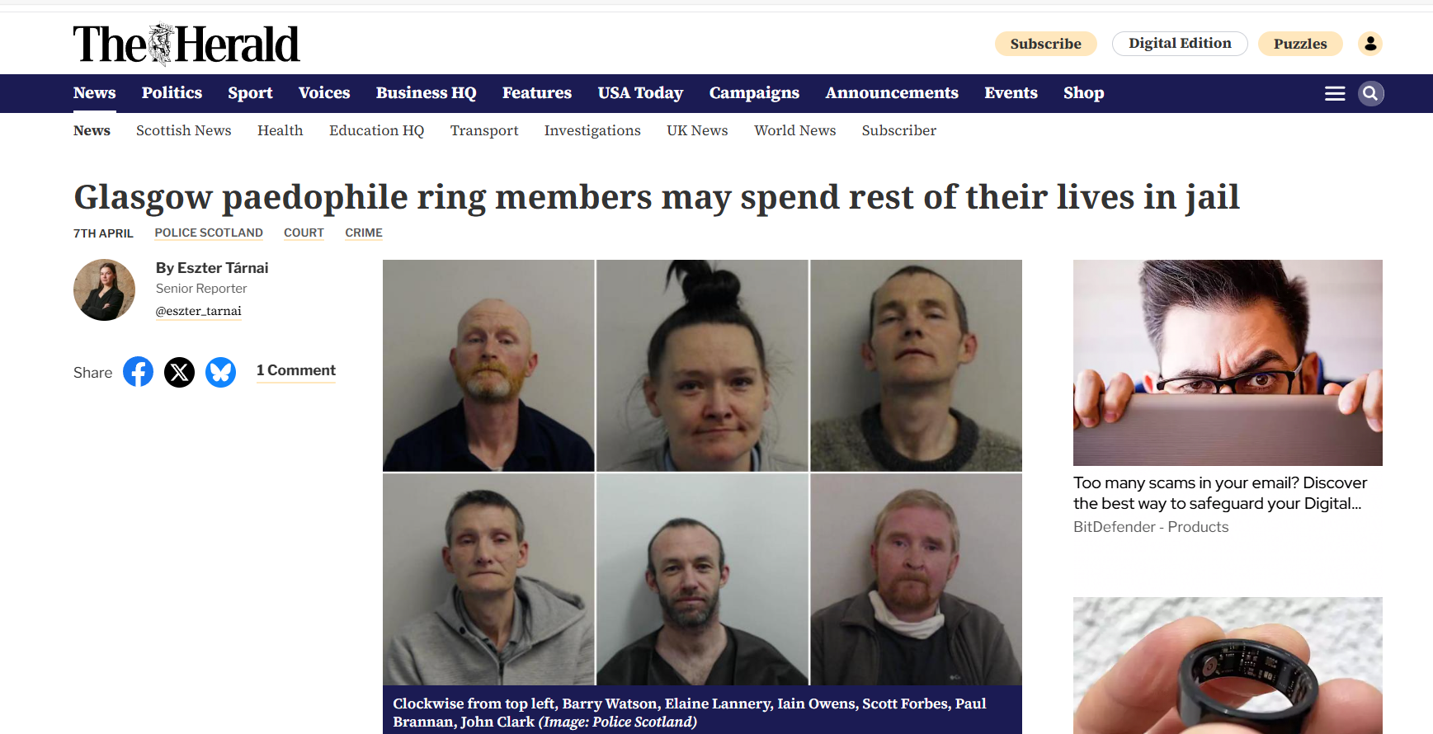
Glasgow Case
7th (?) April 2025
‘Paedophile Ring’
Co-pilot AI question:
When was the article 'Glasgow paedophile ring members may spend rest of their lives in jail' in the Herald' published?
Co-pilot AI ‘Hallucination’:
The article titled "Glasgow paedophile ring members may spend rest of their lives in jail" was published by The Herald on May 15, 2025
https://www.heraldscotland.com/news/25070637.glasgow-paedophile-ring-members-may-spend-rest-lives-jail/

Slide 26
Glasgow Case
29th January 2025
Child Sex Abuse Ring
Seven jailed for 93 years for Glasgow child sex abuse ring
SEVEN people have been jailed for 93 years for their parts in a vile child sex abuse gang in the Glasgow area. The seven members of one of Scotland’s biggest child sex abuse rings were slapped with heavy sentences at the High Court in Glasgow on Monday.. Three victims under the age of 13 were subjected to horrific sexual abuse and violence in a drug den, nicknamed “the beastie house” by the youngsters, over a seven-year period. Taking place between 2012-2019, the offences were reported to police in June 2019, with an extensive investigation afterwards resulting in the arrest and charging of 11 individuals.
During an 11-week trial in 2023, a court heard how there had been “rape nights” at the hands of heroin addicts, with the victims claiming money was exchanged after the sickening attacks whilst some of the attackers laughed. Iain Owens, 46, Elaine Lannery, 40, Scott Forbes, 51, Barry Watson, 48, Lesley Ann Williams, 42, Paul Brannan, 42 and John Clark, 48, were all found guilty of rape and sexual assault.
Owens, Lannery and Williams were also found guilty of attempting to murder a child by trapping them in various places, including a microwave and a cupboard.
The group was jailed for between eight and 20 years, handed orders for lifelong restriction (OLRs) – a life-long sentence usually reserved for the most serious court cases in Scotland that do not involve murder – and placed on the sex offenders’ register indefinitely.
Judge Lord Beckett told the gang, whose jail sentences totalled just over 93 years, that they may never be released from prison. He said: “What you – and the community – should understand is that you may never be released.
“This court is used to hearing the worst examples of human behaviour but such depravity towards young children is beyond my experience.”
Detective inspector Lesley-Ann McGee said: “I hope today’s outcome can help the young victims in moving forward.
“This was a long, complex and challenging investigation for a team of officers and staff who had to work through the most harrowing evidence to bring those responsible for these despicable crimes to justice.
“Since the investigation began we’ve worked closely with a range of partners in Social Work, Health, Education, Crown Office and the third-sector to protect and support the victims.
https://www.deadlinenews.co.uk/2025/01/29/seven-jailed-for-93-years-for-glasgow-child-sex-abuse-ring/

Slide 27
Glasgow Case
27th January 2025
SENTENCING STATEMENTS
https://judiciary.scot/home/sentences-judgments/sentences-and-opinions/2025/01/27/hma-v-iain-owens--elaine-lannery--lesley-williams--paul-brannan--scott-forbes--barry-watson---john-clark
At the High Court in Glasgow, Lord Beckett sentenced Iain Owens, Elaine Lannery, Lesley Williams, Paul Brannan, Scott Forbes, Barry Watson & John Clark to Orders for Lifelong Restriction for their parts in the serious abuse of young children. The punishment parts of the sentences, the minimum time they must spend in prison before being considered for release into the community, were set at: 20 years for Owens; 17 years for Lannery; 14 years for Williams; 15 years for Brannan; 8 years for Forbes; 9 years and 6 months for Watson; and 10 years for Clark.
In sentencing, Lord Beckett said: "This court is used to hearing about some of the worst examples of human behaviour but such depravity as you displayed against young children is beyond my experience. As was said in the aftermath of the trial, this is not typical behaviour. Such extreme abuse of children seems to be rare. In contrast to your awful abuse, the trial also heard evidence demonstrating the best of human qualities. Children showed extraordinary fortitude, strength and stamina undergoing months and years of interviews as investigators struggled to discover and comprehend the full extent of what you had done to them. The oldest two children showed further resilience in the pre-recording of their evidence and, in the case of one of them, at the end of the trial directly to the court by a live TV link. Their exceptional courage and perseverance - in the face of threats made by you Iain Owens - has allowed justice to be done. The children were facilitated by the care and stability provided following their removal in June 2019. However difficult it must have been for all concerned, a married couple accepted the invitation of the social work department to offer respite for the four children who feature in this case. ‘

Slide 28
Glasgow Case
27th January 2025
Iain Owens
https://judiciary.scot/home/sentences-judgments/sentences-and-opinions/2025/01/27/hma-v-iain-owens--elaine-lannery--lesley-williams--paul-brannan--scott-forbes--barry-watson---john-clark
You were convicted of charges 1, 2, 3, 4, 9, 10, 11, 12, 13, 14, 16 (19), 17(21), 18 (22), 19 (23), 21 (26), 24 (30), 31 (39) and 32 (40).
I recognise that you have never served a prison sentence and have only minor previous convictions none of which involved sexual offences. Nevertheless, they are not without significance where, albeit more than 20 years ago, you were convicted of driving whilst disqualified and then breaching the community service order imposed; you have a conviction for attempting to pervert the course of justice in 2003; and in 2018 you breached a community payback order.
When you committed the crimes on this indictment you were in a position of trust. Yours is the worst example in this case of extreme child abuse in gross breach of trust. You caused two children to ingest Class A drugs, with potential to endanger their lives. You dished out routine violence to three young children. Your conduct included repeated acts the jury properly characterised as the attempted murder of child C. From a very young age, you assaulted her by enclosing her in kitchen appliances when her need for care and attention got in the way of your drug taking. Over a period of years, you prioritised only your drug taking and drug dealing, allowing four young children to suffer extreme neglect. Outside agencies and individuals made considerable efforts to help and support the children. The evidence showed how you impeded and substantially thwarted their efforts. You involved child B in dealing heroin and cocaine, using him to courier these class A drugs around your customers.
Over and above these serious crimes, you also committed the most humiliating, degrading and exploitative sexual crimes against young and exceptionally vulnerable children. You began regularly to sexually abuse child A from the age of about 6 as reflected in charge 9 which continued until she was 12. You involved your friend and customer Barry Watson in joining you in sexually abusing her as specified in charge 10, over a number of years before including Paul Brannan and John Clark in this continuing abuse, in addition to Mr Watson. You, Mr Brannan, Mr Watson and Mr Clark repeatedly sexually abused her, until she was 12, as specified in charge 11.
I turn to charge 14. From late 2018 and into 2019, when she was 11 and 12, you induced child A to dance in a sexualised manner and allowed a group of men, including Mr Brannan and Mr Clark, to sexually touch her before they followed your example by perpetrating serious sexual abuse in the most degrading and humiliating of circumstances. Ms Lannery and Ms Williams facilitated, encouraged and applauded your abuse, also encouraged by others, including some who have died. On these regularly repeated occasions, Ms Lannery took payment from those who participated.

Slide 29
Glasgow Case
27th January 2025
Child-on-Child Sex
https://judiciary.scot/home/sentences-judgments/sentences-and-opinions/2025/01/27/hma-v-iain-owens--elaine-lannery--lesley-williams--paul-brannan--scott-forbes--barry-watson---john-clark
Charge 16 involved you Mr Owens causing child B, then only 8, to sexually abuse child A in one form when she was 10, 11 and 12. On charge 18, you induced child B, then 8 and 9, to sexually abuse child A in another form when she was 11 and 12.
Charge 19 discloses that you repeatedly sexually abused child B aged 8 and 9, on one of those occasions with the assistance of Ms Lannery. You and Mr Brannan sexually abused him in a different way, when he was 8, as specified in charge 21. You repeatedly caused him, when he was 6, 7 and 8, to sexually abuse child C, then aged about 1 to 3, as set out in charge 12, encouraged and assisted by Ms Lannery.
On charge 13, you began to grievously sexually abuse child C over two and a half years, aged about 1 to 3. Charge 17 demonstrates that you then carried out further atrocious sexual abuse on child C when she was aged between 2 and 4 along with Ms Lannery, also inducing child A and child B to join in with what you did.
Worst of all, on charge 24, on a number of occasions you sexually abused child C when she was 3, allowing and encouraging Mr Brannan, Mr Forbes, Mr Watson and Mr Clark also to do so in return for payment. You allowed Mr Forbes to film this appalling cruelty, degradation and humiliation physically assisted and facilitated by Ms Lannery and Ms Williams and encouraged by them and others, some of whom who have died.
Given the extreme gravity of what you did and what it reveals about the danger that you present to young children, I am not satisfied that normal licence arrangements would protect the public from you causing serious harm on release from prison.

Slide 30
Glasgow Case
27th January 2025
Duplicitious Success
https://judiciary.scot/home/sentences-judgments/sentences-and-opinions/2025/01/27/hma-v-iain-owens--elaine-lannery--lesley-williams--paul-brannan--scott-forbes--barry-watson---john-clark
Whilst there is a basis on which Dr Pratt considers that you present medium risk, that is not a complete answer in your favour.
Dr Pratt expresses optimism that you can be managed by licence conditions in the future but at no point in his assessments has he taken account of the level of support offered and the oversight to which you and your household were subject for years by agencies including social work, health visitors, teachers and church volunteers. When it suited your purposes, you were adept at restricting the access of those charged with ensuring the children were cared for and fed. You ensured the children could never speak to them unless you or Ms Lannery was present to ensure they did not disclose your crimes. Your duplicitous success in avoiding detection under such close scrutiny bodes ill for effective monitoring and supervision in the future.

Slide 31
Glasgow Case
27th January 2025
Lesley Williams
https://judiciary.scot/home/sentences-judgments/sentences-and-opinions/2025/01/27/hma-v-iain-owens--elaine-lannery--lesley-williams--paul-brannan--scott-forbes--barry-watson---john-clark
Lesley Williams
You were convicted of charges 4, 14, 24 (30), 31 (39) and 32 (40).
I note that, albeit they date back to 2004 and 2005, you have three convictions for assault. One is aggravated by robbery and two are aggravated by causing injury. Seven of your convictions were committed when you were on bail. You have previous convictions for being concerned in supplying class A drugs, heroin, in 2015 and 2016 and the evidence in the trial disclosed substantial involvement in supplying both heroin and cocaine over a significant period. Part of this was done in proximity to vulnerable children.
This would itself attract significant punishment, not least because a third conviction for trafficking class A drugs attracts a minimum, sentence of 7 years but, in this case, it is overshadowed by your serious physical and sexual abuse of young children. This includes the attempted murder of a very young child and appalling sexual abuse of two young children, child A and child C, on repeated occasions, and inducing the involvement of a third, child B, on charge 24. You physically assisted several men as you and others encouraged and applauded what was happening on charge 24.
I note from the social work report that you did not engage with child protection plans and support for your own children. Records suggest that you had unsupervised contact with your own children in breach of bail conditions in these proceedings. You have frequently offended when on bail.

Slide 32
Glasgow Case
27th January 2025
Scott Forbes
https://judiciary.scot/home/sentences-judgments/sentences-and-opinions/2025/01/27/hma-v-iain-owens--elaine-lannery--lesley-williams--paul-brannan--scott-forbes--barry-watson---john-clark
Scott Forbes
You were convicted only of charge 24 (30) but you filmed what went on and yourself inflicted exceptionally serious sexual abuse on a child of 3 on repeated occasions in the dreadful circumstances disclosed in the evidence. You have a very limited criminal record but it is not without significance that a previous offence was committed when you were on bail.
I have considered the different level or risk you are assessed as presenting in the two risk assessment reports before the court. In light of the evidence I heard in the trial, I am not persuaded by the argument that you were somehow swept along by others to do things you would not have done by yourself. You were entrusted with specific and significant roles in the repeated commission of these crimes. I have already mentioned filming. Sometimes you operated a timer and would go last in the knowledge of what had gone before and the condition of the child. You also bear criminal responsibility for inducing child B to engage in what was happening.
In light of the nature of your repeated criminal conduct committed as a mature adult in mid-life and your integral role on the occasions described, the information in the social work and risk assessment reports in one of which you are deemed to present a high risk I am unpersuaded by the argument that I should impose an extended sentence. I am satisfied that the risk criteria are probably met.
Had I not been imposing an order for lifelong restriction I would have imposed a prison term of 19 years.

Slide 33
Glasgow Case
31st October 2023
‘Witches & Wizards’
A child sex abuse ring operated in a drugs den surrounded “by witches and wizards”, a court has heard.
Three children were said to have been victims of a litany of sex crimes including rape and sexual abuse in a drug den where heroin and crack cocaine were used.
In her closing speech for the Crown, advocate depute Cath Harper told the High Court in Glasgow the children were allegedly subjected to “group rapes” by 11 accused, some of whom also face charges of attempted murder.
The older children were alleged to have been forced to abuse a younger child.
It is also alleged dogs were tortured, although Ms Harper said there was “no forensic evidence of these events happening”.
A child alleged a polythene bag was put over her head while another child was allegedly put inside a microwave, Ms Harper said.
An allegation the 11 accused used an Ouija board or similar object to “call on spirits and demons” causing the child victims to “believe that they could see, hear and communicate with spirits and demons” and making them take part in “witchcraft” has been dropped.
https://www.independent.co.uk/news/uk/crime/glasgow-high-court-dna-evidence-b2439167.html

Slide 34
Glasgow Case
5th September 2023
‘Satanic Child Abuse Ring’
The children were also allegedly made to participate in classes involving witchcraft, spells and wands which made them believe that they had “metamorphosed into animals”, court documents show.
One girl was chased by people wearing devil masks, hung by her clothing from a nail on the wall, shut in a microwave, an oven, a fridge, a freezer and cupboards, the court heard.
Owens, Lannery, Williams, Brannan, Clark are also charged with attempting to murder the girl, who was also allegedly made to act like a dog and eat dog food.
The group, which is also charged with stabbing and abusing dogs, also made one child dress in lingerie and “dance in a sexualised manner” on various occasions between 1 October 2018 and 19 June 2019, the indictment claims, before she was raped by male members of the group.
The women are accused of watching, with the indictment adding that they did “clap, cheer and verbally encourage” the abuse, with some filming the attack.
Children were also allegedly forced to repeatedly sexually abuse each other with household items.
In one horrifying charge, a young child was restrained in her cot as men raped her, while others cheered and took video recordings, the court heard.
https://www.independent.co.uk/news/uk/crime/glasgow-high-court-dna-evidence-b2439167.html
https://www.independent.co.uk/news/uk/crime/glasgow-child-abuse-ring-horrors-b2446927.html

Slide 35
Glasgow Case
5th September 2023
11 Accused (+3 Dead)
Eleven people have gone on trial accused of taking part in a child sex abuse ring involving witchcraft, attempted murder and the killing of dogs.
Seven men and four women are charged with 32 offences between them, including forcing children to participate in seances - using a Ouija board or similar - to "call on spirits and demons".. The alleged victims were also reportedly made to watch and participate in classes involving witchcraft, point wands and utter spells that caused them to believe they had "metamorphosed into animals".
It is also claimed children were raped on various occasions while members of the group did "clap, cheer and verbally encourage" the attacks, as well as film them, prosecutors say.
Five of the accused also face an attempted murder charge for trapping a child in a cupboard.
The alleged victim was also reportedly forced to act like a dog, eat dog food, was hung by their clothing from a nail on the wall, and was pushed into a microwave oven.
Each of the accused has also been charged with abusing and killing a number of dogs, including forcing two children to stab the animals.
Other charges include causing children to take part in sexual activity, forcing a child to courier drugs, possessing diamorphine and cocaine, and supplying the Class A drugs.
The alleged sexual and non-sexual crimes - which include charges involving three girls and a boy - are said to have taken place across Glasgow between 2010 and 2020. The first offence involving a child is alleged to have happened in 2012.
Iain Owens, 45, Elaine Lannery, 39, Lesley Williams, 41, Paul Brannan, 41, Marianne Gallagher, 38, Scott Forbes, 50, Barry Watson, 47, Mark Carr, 50, Richard Gachagan, 45, Leona Laing, 51, and John Clark, 47, deny all the charges against them.
Maureen Goudie, Steven McHendrie and Robert Brown are also mentioned as being involved in a number of the charges, but court papers said they are now deceased.
https://news.sky.com/story/eleven-on-trial-over-alleged-child-sex-abuse-and-witchcraft-in-glasgow-12955537

Slide 36
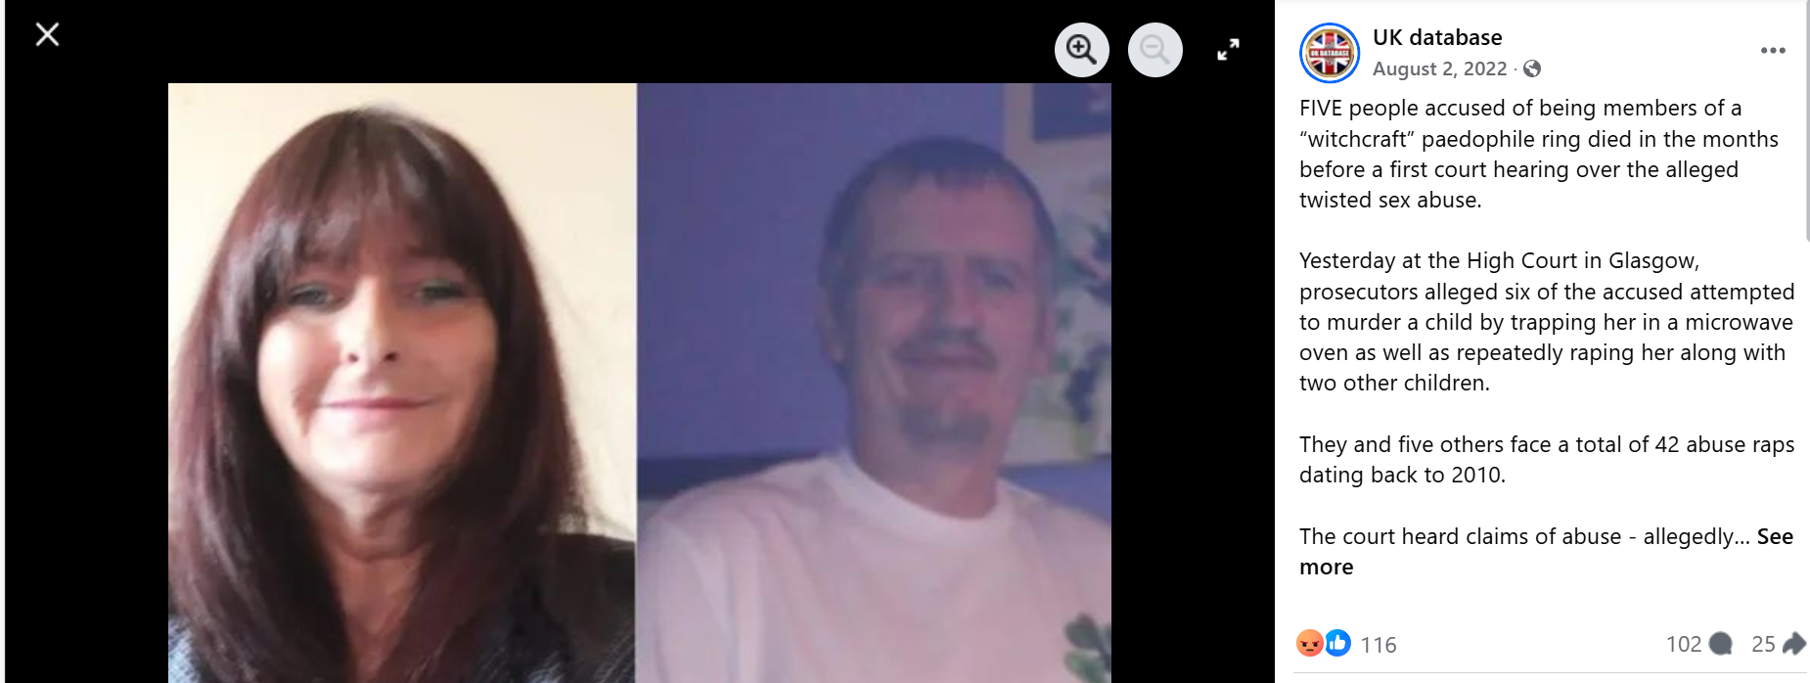
Glasgow Case
2nd August 2022
5 Dead before Hearing
Steven McHendrie, Maureen Goudie and Robert Brown were found dead after their October 2020 arrests. We can now reveal two more men accused of having raped a girl have also passed away. James McLean and Douglas Gachagan are named in one of the rape charges with five other males accused and McHendrie, 55. McHendrie’s death in January came eight months after Goudie, 50, died and a year on from the death of Robert Brown, 51.
https://www.facebook.com/photo/?fbid=1173448096602025&set=a.283509945595849
Mr Owens and Ms Lannery first face a charge of neglecting the three youngsters along with another child.
https://www.bbc.co.uk/news/uk-scotland-62384842

Slide 37
Case 1
Vignette
Appeal

Slide 38
https://www.researchgate.net/publication/337001751_The_Legacy_of_Satanist_Ritual_Abuse_SRA_Trauma_Mind_Control_A_C-PTSD_Assessment_Case_Study

Slide 39
Case 2
Vignette
Age 1-2 Years

Slide 40
Case 2
Vignette
Age 4 Years

Slide 41
Case 3
Vignettes
Medical Record Entries Age 5 to 12:
Half a dozen entries sensitive parts (back)
Half a dozen entries sensitive parts (front)
Half a dozen skin, headache and injury entries
Medical Record Entry Age 5 Years:
Infant feeding problem
Education Record Entry Age 5 Years:
Sucks toothbrush
Episode Age 8 Years:
Faints when medical personnel apply white cream to top of hand

Slide 42
Academic Research
Prof Michael Salter

Slide 43
2025 Survivorship Conference
Clinician Day 16th May
Successful Investigations of Extreme Abuse Cases –
The Role of Mental Health Professionals in Family Courts
Dr Rainer Hermann Kurz
C.Psychol
ichinendaimoku@gmail.com
For ‘Thorge’
The name Thorge has Irish origins and is derived from the Gaelic name Ó Tormaigh, meaning "descendant of Tormaigh". The name Tormaigh itself is believed to come from the word tormach, which means "thunder". This gives the name a strong and powerful connotation, often associated with resilience and authority.
https://www.researchgate.net/profile/Rainer-Kurz/publications

